Slide 1
Flexible Slender Bodies Control Thesis Progress Review 1
Anatole VERHAEGEN
Supervisor : Prof. Rafał Żbikowski
MBDA coordinator : Mr Graham Wallis

Slide 2
Background Literature
Thesis Objectives & Schedule
Actual Progress

Slide 3
Background Literature
Control of Flexible Structures
Modelling & Order Reduction
Sensors & Actuators Technology
Sensors & Actuators Placement

Slide 4
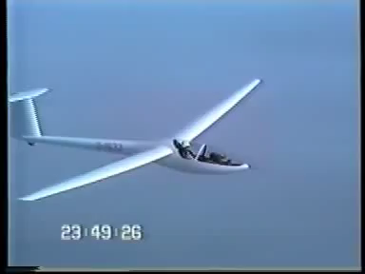
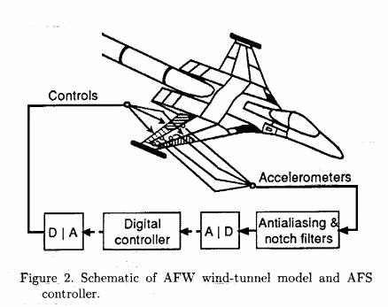
Background Literature Control of Flexible Structures
Active flutter suppression*:
Implemented by NASA in 1992
Uses 1 accelerometer and 1 control surface
Increases the flutter dynamic pressure
Flutter on a Glider
*M. R. Waszak and S. Srinathkumar, "Design and experimental validation of a flutter suppression controller for the active flexible wing", NASA Langley Research Center; Hampton, VA, United States Aug 1992

Slide 5
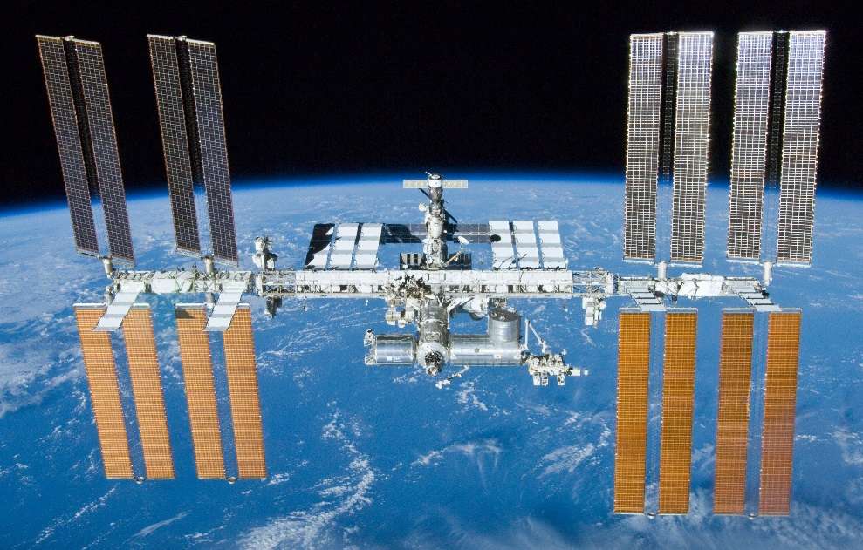
Background Literature Control of Flexible Structures
Active flutter suppression
Large Space Structures attitude control*:
Control of rigid-body modes and elastic modes
Investigation of sensor and actuator placement
Dissipative controllers advantages
*Joshi, S. M., Maghami, P. G. and Kelkar, A. G, “Dynamic dissipative compensator design for large space structures”, NASA Langley Research Center, 1991

Slide 6
Background Literature Control of Flexible Structures
Active flutter suppression
Large Space Structures attitude control
Control of flexible structure during time-dependent maneuvres*:
Association between flight dynamics and elastic modes
Discrete-time approach
Time-varying controller
*Meirovitch & Tuzcu, “Control of Flexible Aircraft Executing Time-Dependant Maneuvres”, AIAA 2004-1634, 2004

Slide 7
Background Literature Modelling & Order Reduction
Accuracy of modelling:
Method | Accuracy on modes
Finite Element Method | 10%
1st Model Identification | 5%
2nd Model Identification | 1-2%
Error due to modelling methods*
*Jer-Nan Juang, “Applied System Identification, Prentice Hall“, 1994

Slide 8
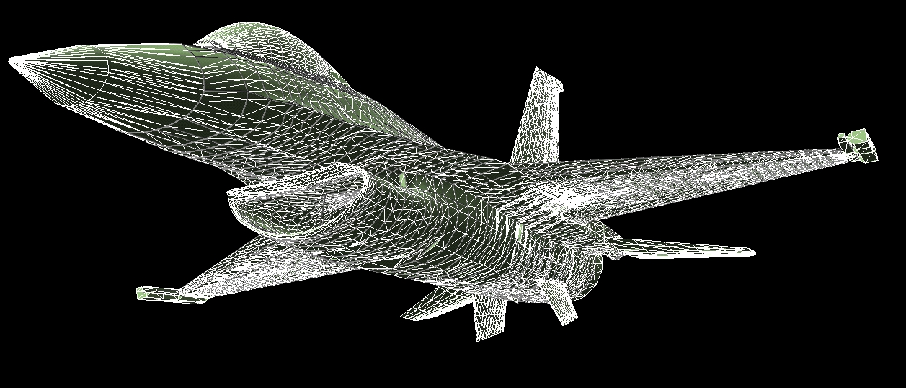
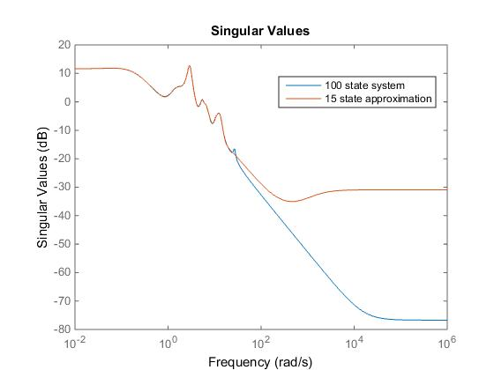

Background Literature Modelling & Order Reduction
Accuracy of modelling
Order reduction*:
Truncation techniques ($H^{2},H^{∞}$)
Frequency weighted techniques
F-16 FEM : 166,536 nodes
* Wodek K. Gawronski, “Dynamics and Control of Structures: A Modal Approach” (Mechanical Engineering Series) Hardcover – September 11, 1998

Slide 9
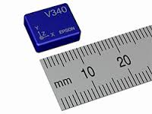
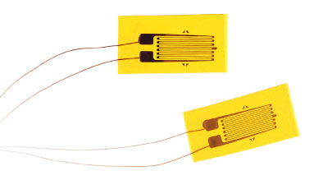
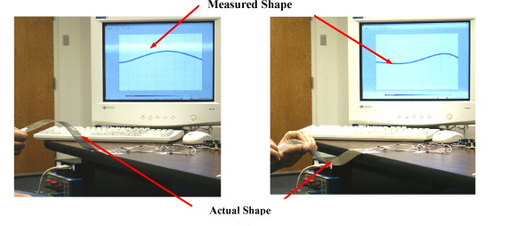
Background Literature Sensors & Actuators Technology
Sensors:
Accelerometers and gyrometers
Strain gages
Distributed sensor network*
6 Axis IMU
Strain Gages
Strain Sensor Network
*S. Laflamme et al., “Soft Elastomeric Capacitor Network for Strain Sensing Over Large Surface”, IEEE 2013

Slide 10
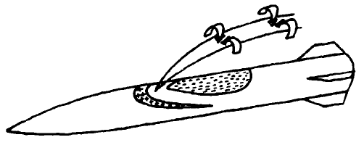
Background Literature Sensors & Actuators Technology
Actuators:
Ailerons
Hot gas jets (PIF-PAF)*
Cold gas jets^{Ϯ}
Lateral Jet Control*
*G. Selince, “Un Nouveau Concept de Pilotage des Missiles Application Aux Sol-Air“ - AEROSPATIALE - DIVISION DES ENGINS TACTIQUES
^{Ϯ} V. Viti, R. Neel, and J. A. Schetz, “Detailed flow physics of the supersonic jet interaction flow field” - PHYSICS OF FLUIDS 21, 046101 2009

Slide 11
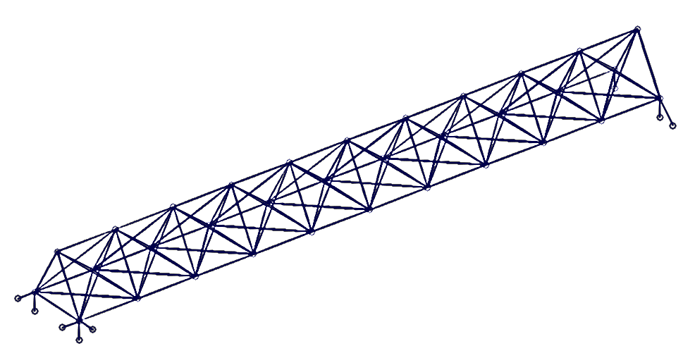
Background Literature Sensors & Actuators Placement*
Possible sensor location
Possible actuator location
* Wodek K. Gawronski, “Dynamics and Control of Structures: A Modal Approach” (Mechanical Engineering Series) Hardcover – September 11, 1998

Slide 12
Thesis Objectives & Schedule
Objectives of the Thesis
Gantt Chart Schedule

Slide 13
Objectives
Model an existing missile – Rigid-body modes + elastic modes
Make appropriate modifications (actuators / sensors)
Cost-effective
Not intrusive
Design an implementable controller
Double the bandwidth of the system
Same performance with a lighter structure
Halve vibrations magnitude

Slide 14
Gantt chart
Final Controller Designed
12/7/2015
Choice of Missile & Modifications
Thesis Progress Review 2
18/5/2015
13/7/2015
Final Model Complete
Thesis Hand-in
16/6/2015
12/8/2015
2015
February
March
April
May
June
July
August
2015
Today
Literature Review
Lumped Element Model Studies
FEM & Aerodynamics Modelling
Specifications Definition
Controller Design
Performance Assessement
Thesis Writting

Slide 15
Actual Progress
Lumped Element Models & Simulations
Contacts within MBDA

Slide 16


Lumped Element Models Modelling
Turbulence
α₁
ASTER 30 - Anti-Ballistic Missile
(Surface-To-Air)
L₁
Structural model :
2 rigid rods
1 torsion spring (1% damping)
Constant mass
Aerodynamic model :
Lift applied at CG of each rod
Mach 4.5
Von Karman turbulence model
L₂
Thrust vector control
α₂
Details

Slide 17
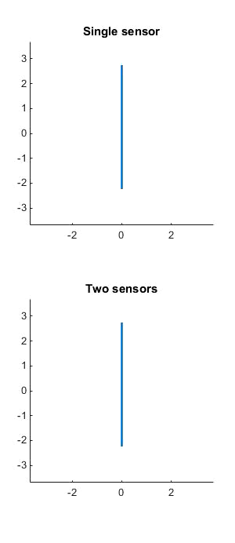
Lumped Element Models Simulation
Controller designed without elastic modes
Controller designed with elastic modes

Slide 18
Contacts within MBDA
MBDA Coordinator: Mr Graham Wallis – 08/04, 24/04. Next : 18/05
Visit of BAe ATC – End of May
Meeting with an MBDA control engineer – 18/05

Slide 19
Thank you

Slide 20
Final Controller Designed
12/7/2015
Choice of Missile & Modifications
Thesis Progress Review 2
18/5/2015
13/7/2015
Final Model Complete
Thesis Hand-in
16/6/2015
12/8/2015
2015
February
March
April
May
June
July
August
2015
Today
Literature Review
Lumped Element Model Studies
FEM & Aerodynamics Modelling
Specifications Definition
Controller Design
Performance Assessement
Thesis Writting

